Slide 1

AUTOMATIC SUMMARIZATION
OF USER REVIEWS
Under the Supervision of:
Dr. Parul Yadav
Dr. Aditi Sharma
Computer Science & Engineering Department
PRESENTED BY:
DURGESH 1705213018
SHUBHAM SINGH 1705213029
HARSH KUMAR 1900520139001

Slide 2
CONTENTS
Introduction
Problem Statement
Related Works
Proposed Methodology
Implementation and Flow Graph
Future Work and Challenges
References

Slide 3

INTRODUCTION
What is Summary?
It conveys important information in the original text(s).
It is no longer than half of the original text(s) and usually significantly less than that.
Automatic Text Summarization:
Text summarization is the process of distilling the most important information from a source (or sources) to produce an abridged version for a particular user (or users) and task (or tasks).

Slide 4

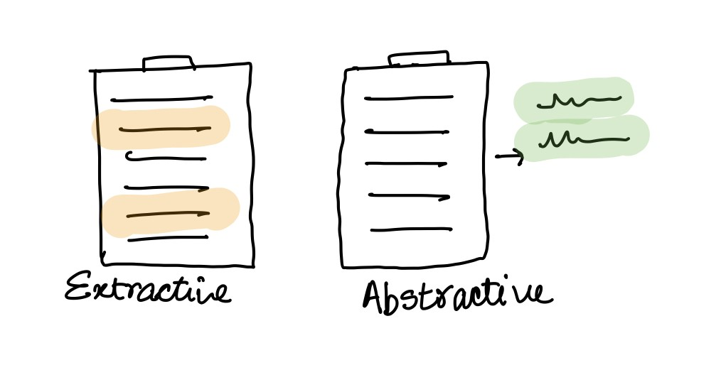




Text summarization can be done in two ways
Extractive text summarization:
Select Parts – Sentences – from the original text –works unsupervised.
So, identifying the right sentences for summarization is of utmost importance in an extractive method.
Abstractive text summarisation:
Creates novel sentences using NLG – works with Deep learning.
So it generates an entirely new summary.

Slide 5
RELATED WORKS
A survey of Automatic Text Summarization Progress, Process & Challenges (2021)
By M. F. Mridha, A. A. Lima, K. Nur, S. C. Das, M. Hasan and M. M. Kabir
In this they’ve done an analysis of all the methods of text summarization to date they’ve used 324 research papers did analysis.
In the paper they discuss the limitations and challenges of various algorithms and ATS methods.
In challenges they’ve talked about giving priority to producing robust summary and ATS should be made intelligent by integrated systems.
Automatic text summarization: A comprehensive survey, Expert Systems with Applications(2021)
By Wafaa S. El-Kassas, Cherif R. Salama, Ahmed A. Rafea, Hoda K. Mohamed
In this, they talked about various places where ATS can be used like multi-document user-specific summarization, query-based, domain-specific etc
Research community is focused on extractive summarization using different methods and techniques to achieve meaningful summaries as the abstractive approach is highly complex and extensive NLP.

Slide 6
PROBLEM STATEMENT
Objectives:
Study and Compare existing text summarization methods.
To identify gaps in existing tools used for Automatic text summarization.
Design and implement a tool or model for automatic summarization of user reviews.

Slide 7
FLOWGRAPH
Collection of Dataset
Calculation of polarity of sentences and giving them scores
TextRank algorithm to summarise the positive and negative sets
2
4
Pre-processing or cleaning of data.
Separation of data into positive and negative sets according to their score.
1
3
5

Slide 8
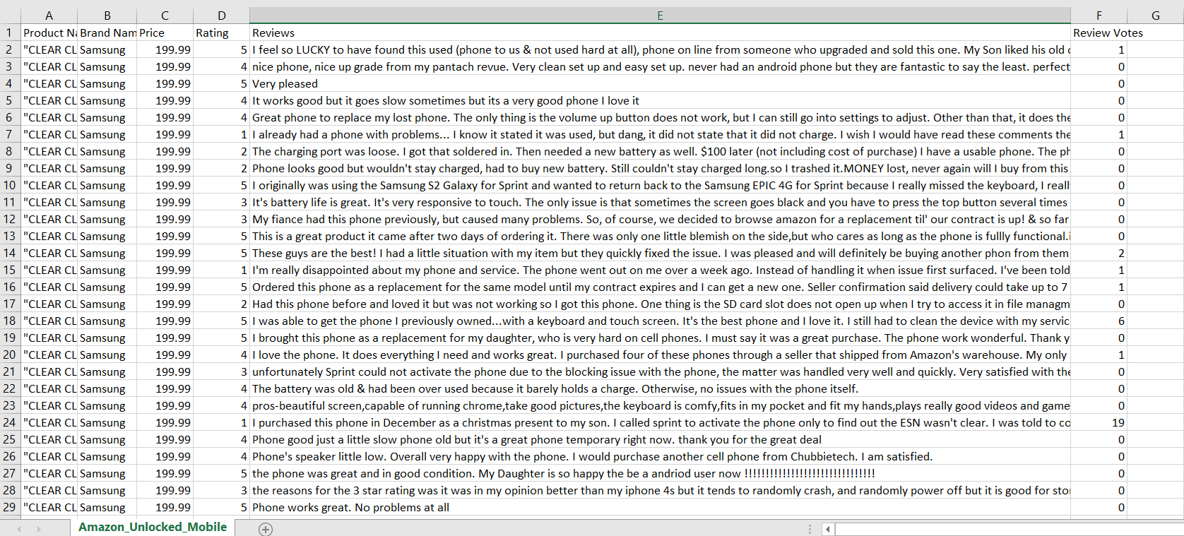
SCREENSHOT OF DATASET

Slide 9

Pre-processing or cleaning of data
Used Natural Language toolkit(NLTK) library to do the pre-processing of data.
Removing Stop words
Stemming
Removing special characters
Lower Casing
Tokenization
[‘a’, ‘an’, ‘the’, ‘is’] etc.
‘programmer’, ‘programing, ‘program’ → ‘program’.
? < = [.,] )(?= etc.
Capital letter are Lower cased
Sentences are
Tokenized into
words.

Slide 10
PROPOSED METHODOLOGY Calculation of Polarity (using text blob and vader)
Vader
Vader sentiment returns the probability of a given input sentence to be positive, negative, and neutral.
Compound [-1,1] : -1 indicates negative sentiment and +1 indicates positive sentiments.
Textblob
Polarity [-1,1], -1 indicates negative sentiment and +1 indicates positive sentiments.
Subjectivity [0,1] Subjective sentences generally refer to opinion, emotion, or judgment.

Slide 11

Separation of Data into Positive and Negative sets according to their sentiment score.
Calculating Sentiment Score
We’ve calculated the sentiment score by multiplying the compound score and subjectivity score to identify these sets.
Creating Sets
Sorted the stored products and the most negative and the most positive sentences are selected on the basis of sentiment score.

Slide 12
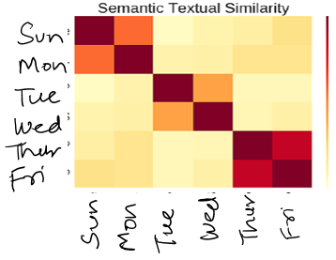
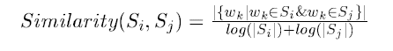
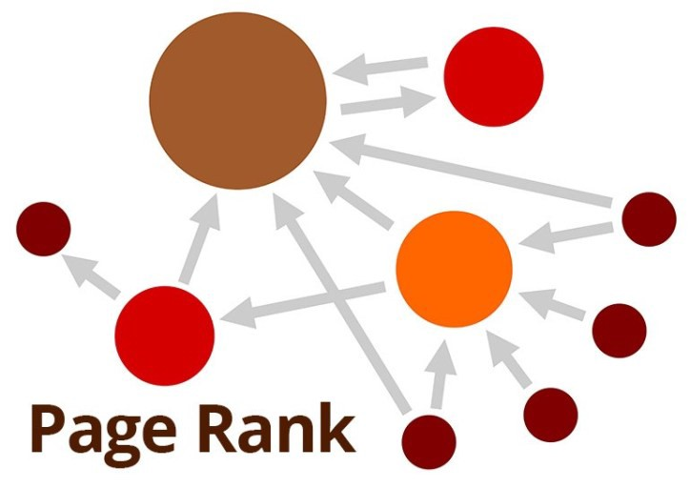







TEXT RANK ALGORITHM
It involves pulling key phrases from the source document and combining them to make a summary.
Create a similarity matrix – Fig 1.
Representing Sentences as Nodes in the graph – Fig 2.
Connecting nodes based on a similarity matrix.
Ranking the sentences

Slide 13
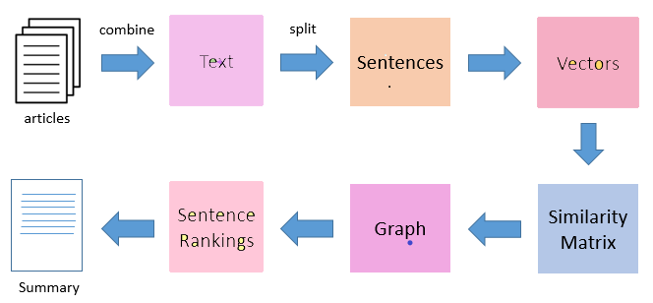
summarizINg negative and positive sets steps for text rank algorithm
Separating sentences into positive and negative sets.
Creating word embedding using the Glove Vector model
Creating a Similarity matrix of positive and negative sentences
Sentence
Rankings
Generating graph with nodes as Sentences and edges as a score of similarity

Slide 14

RESULT OUTPUT
We ran three instances of our model, each based on a different feature set.
Battery
Camera
Screen

Slide 15
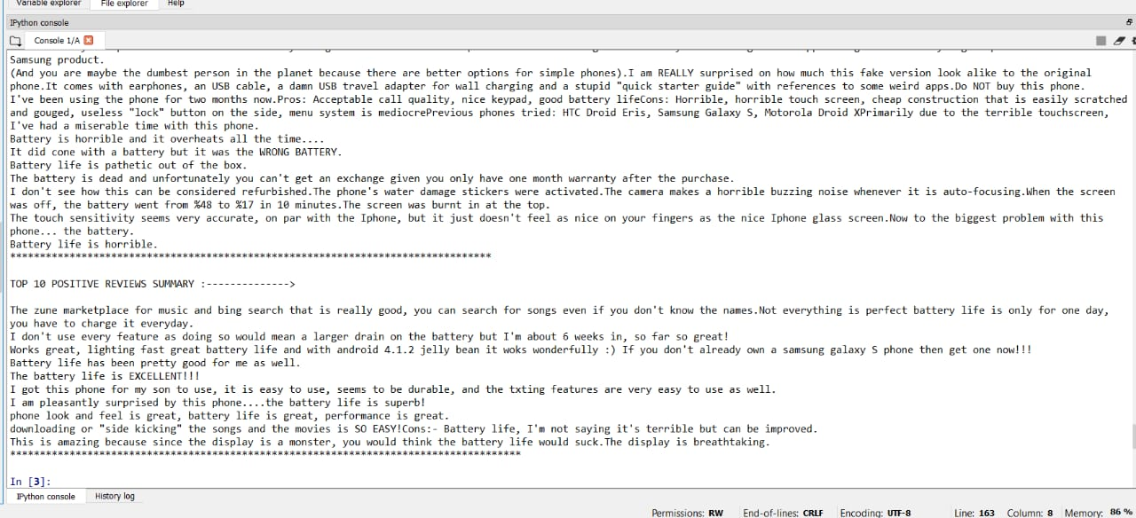
Top 10 positive reviews on selecting battery feature.

Slide 16
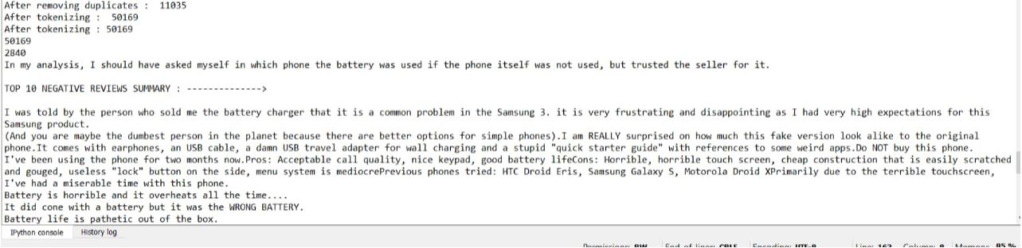
Top 10 negative reviews on selecting battery as the feature.

Slide 17
RESULT ANALYSIS
We also evaluated those results on based on two metrics:
Model Efficiency (ME)
Time efficiency (TE)

Slide 18
Model Efficiency (ME)
It is the percentage of the reviews that our model is able to classify as positive and negative.
There were certain reviews, which could not be classified as positive or negative.
We call those reviews neutral reviews and those reviews were left out by our model during classification.
ME = (𝑻𝒐𝒕𝒂𝒍 𝒑𝒐𝒔𝒊𝒕𝒊𝒗𝒆 𝒓𝒆𝒗𝒊𝒆𝒘𝒔 𝒈𝒆𝒏𝒆𝒓𝒂𝒕𝒆𝒅 + 𝑻𝒐𝒕𝒂𝒍 𝒏𝒆𝒈𝒂𝒕𝒊𝒗𝒆 𝒓𝒆𝒗𝒊𝒆𝒘𝒔 𝒈𝒆𝒏𝒆𝒓𝒂𝒕𝒆𝒅)
𝑻𝒐𝒕𝒂𝒍 𝒓𝒆𝒗𝒊𝒆𝒘𝒔 𝒂𝒗𝒂𝒊𝒍𝒂𝒃𝒍𝒆

Slide 19

Time efficiency
It is the factor increase in the reading time.
HOW TO CALCULATE??
We found out that the average human reading rate is 225 words/ minute. We can then estimate the time taken to read all the reviews, given the average reading rate of humans.
We also know the execution time of our program and the number of reviews generated by our program. Hence, we can determine the time taken to generate the best reviews out of the review corpus.
Finally, we can calculate the ratio of time taken by a person to read all the reviews and the time taken by a person to read the best reviews generated. This ratio will tell us the factor increase in the efficiency of reading time.

Slide 20
RESULT TABLE
FEATURES | MODEL EFFICIENCY | TIME TAKEN (SEC)
Battery | 65.77% | 74
Camera | 74.94% | 40
Screen | 72.84% | 74

Slide 21


FUTURE WORK & CHALLENGES
Summarize opinions by selecting a specific feature from the pool of features of a product.
Increase in the accuracy of the summary obtained.
Decrease Redundant Sentences that appear in our summary.
Providing answers to queries to customer questions.

Slide 22
REFERENCES
M. F. Mridha, A. A. Lima, K. Nur, S. C. Das, M. Hasan and M. M. Kabir, "A Survey of Automatic Text Summarization: Progress, Process and Challenges," in IEEE Access, volume 9, pp. 156043-156070, 2021, doi:10.1109/ACCESS.2021.3129786. (2021)
Kumar, Y., Kaur, K. & Kaur, S. Study of automatic text summarization approaches in different languages. ArtifIntell Rev 54, 5897–5929 https://doi.org/10.1007/s10462-021-09964-4 (2021)
Wafaa S. El-Kassas, Cherif R. Salama, Ahmed A. Rafea, Hoda K. Mohamed,Automatic text summarization: A comprehensive survey, Expert Systems with Applications,Volume 165,113679 ISSN 0957-4174,https://doi.org/10.1016/j.eswa.2020.113679. (2021)
Atif, Naomie and Yogan. P ,Genetic semantic Graph Approach for multi documentabstractive Summarisation. Fifth International Conference on Digital Information Processingand Communications (ICDIPC)(2015).
Hongyan, Sentence Reduction for Automatic Text Summarization, P.(2008).

Slide 23

Thank You.
ANY QUERIES?

